Slide 1


Crime Data Analysis
Ekansh Agnihotri
22/08/2024

Slide 2


About
A year ago in Chicago, the high incidence of crime prompted the government to take decisive action by launching an operation with top-performing police officers.
Proper actions were taken to reduce the crime incidents and improve the living condition in Chicago.
Various results were obtained in the form of data and needed to be analyzed to present a report about all the initiatives of the crime department.

Slide 3

Problem Statement
The government wants to analyze the changes and improvements in crime rates. The government is seeking the following objectives from the analysis:
If the case-solving time improved.
What are the localities where the crime rate was higher.
What can be the measures that can be taken to improve the crimes further.

Slide 4





Criminal Instances
ROBBERY
MURDER
NARCOTICS
THEFT

Slide 5

Data Overview
The crime_data_2022 dataset allows for an in-depth understanding of the crime reporting in Chicago.
The data consist of 20 columns with information regarding the location, date and time, type of crime etc.
The crime department of Chicago operates in 22 districts.
28 different types of crime cases were reported in the year 2022.
The data also includes Domestic & Arrest columns to differentiate between domestic and non-domestic cases and was there any arrest or not pertaining to the crime.

Slide 6
Methodology
Understanding the Data
Cleaning the Data
Exploring the Data
Deriving Key Insights

Slide 7
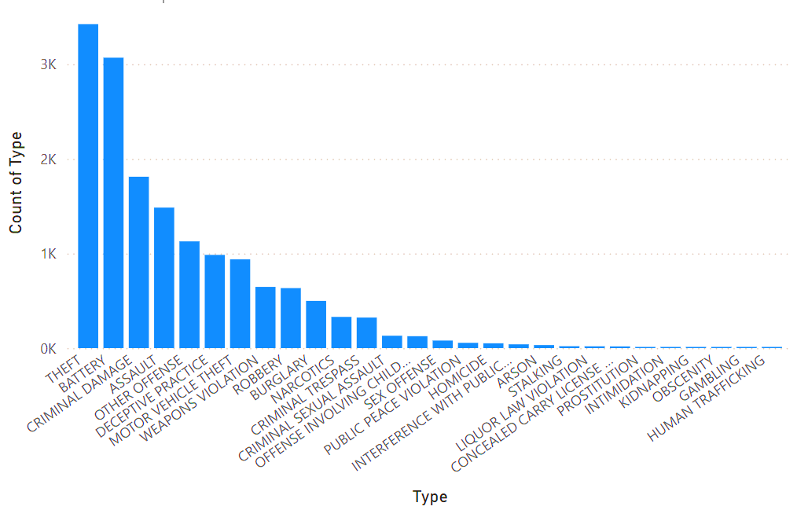
Objective Questions
Crime Type Analysis: Assess the frequency of each crime type to identify the most prevalent crimes occurring in the area.
Key Takeaways: -
It can be clearly seen that the THEFT & BATTERY cases are the most prevalent ones.
There are 3513 THEFT and 3073 BATTERY cases registered in the year 2022.
Recommendations: -
Deploy a greater number of patrol officers near residential & commercial areas to decrease the incidents of theft.
Patrolling should be done at regular intervals.
Stricter actions should be taken against the criminals.

Slide 8
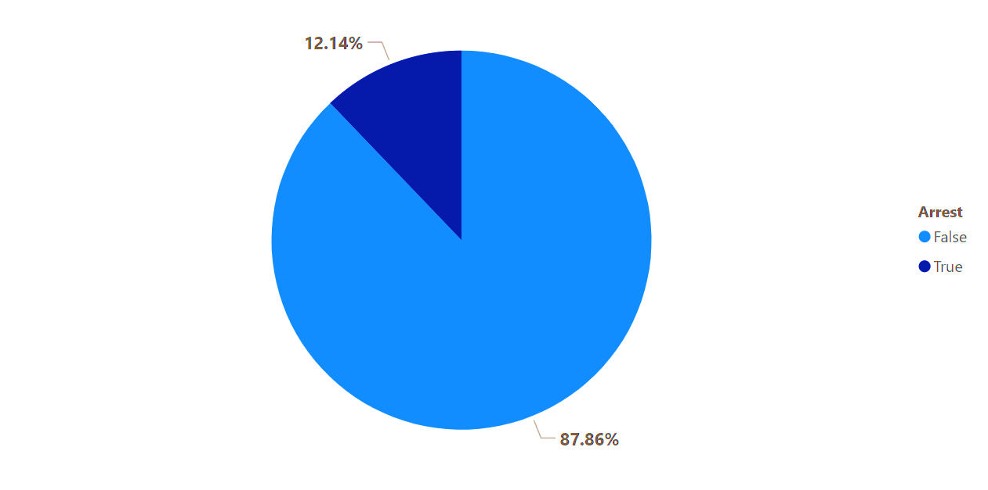
Objective Questions
Arrest Rate Evaluation: Analyze the percentage of reported incidents that have resulted in an arrest to gauge law enforcement effectiveness.
Key Takeaways: -
Only 12.14% of the total cases reported had an arrest.
It is evident through this chart that the total arrest rate in Chicago is less.

Slide 9
Objective Questions
What is the average time between reporting and solving a case as per the data?
Key Takeaways: -
It takes almost half a year to solve a single case in the area.
This data shows that there is burden of pending cases on the crime department.
201.64
Average days in Solving Case

Slide 10
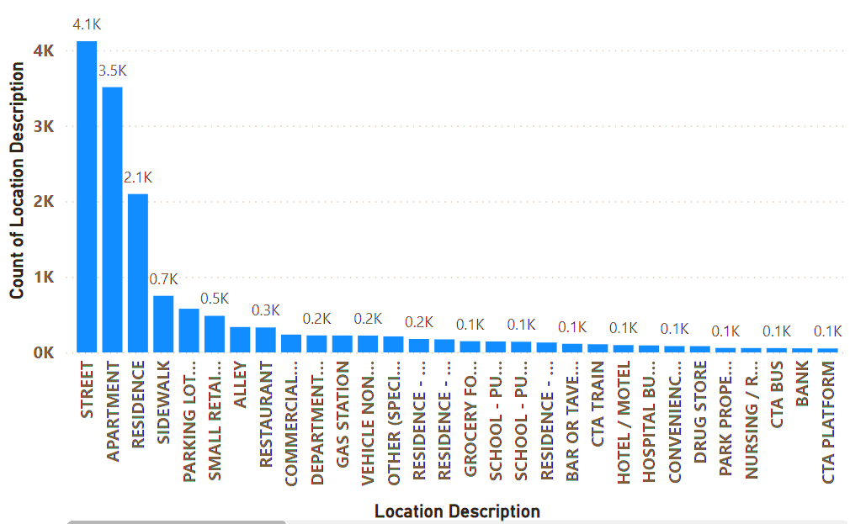
Objective Questions
Is there any “Location Description” where the number of crimes is higher than expected? Come up with a table or visualization in which one can judge the frequency of crimes at each Location Description type.
Key Takeaways: -
It shows that the STREETS of Chicago are unsafe and most of the crimes occur here only.
Also, the data of APARTMENT cases are also shocking and security system should be improved.
Almost 48% of the total cases reported are of incidents happening on the STREETS & APARTMENTS.

Slide 11
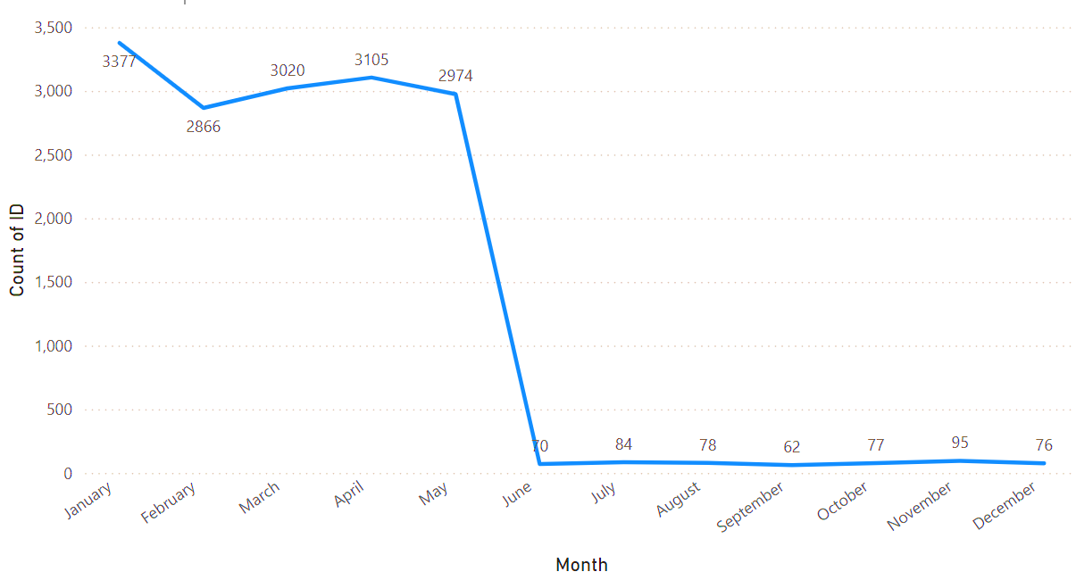
Subjective Questions
Is there any month-wise change in crime rates? If not, what could be the mistake in that operation?
Key Takeaways: -
There is a drastic decrease in the number of crimes between the month of May & June.
The operation has generated positive results and there is decrease in the number of crimes in the second half of the year.

Slide 12
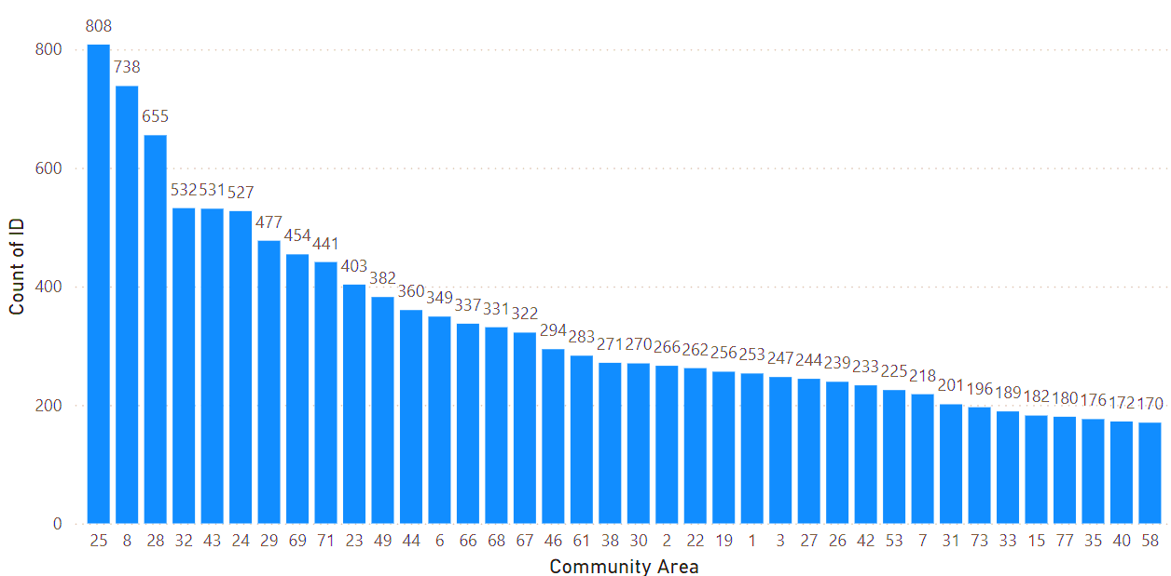
Subjective Questions
Which localities experience higher crime rates, and what measures can we ensure to reduce these numbers?
Key Takeaways: -
The community area number 25, 8 & 28 have recorded higher number of cases filed with maximum 808 cases in community area 25 according to the data.
Recommendations: -
CCTV should be installed at regular intervals in the area.
Vigilant patrolling officers should be appointed frequently.
Strict punishments to the criminals to set an example.

Slide 13
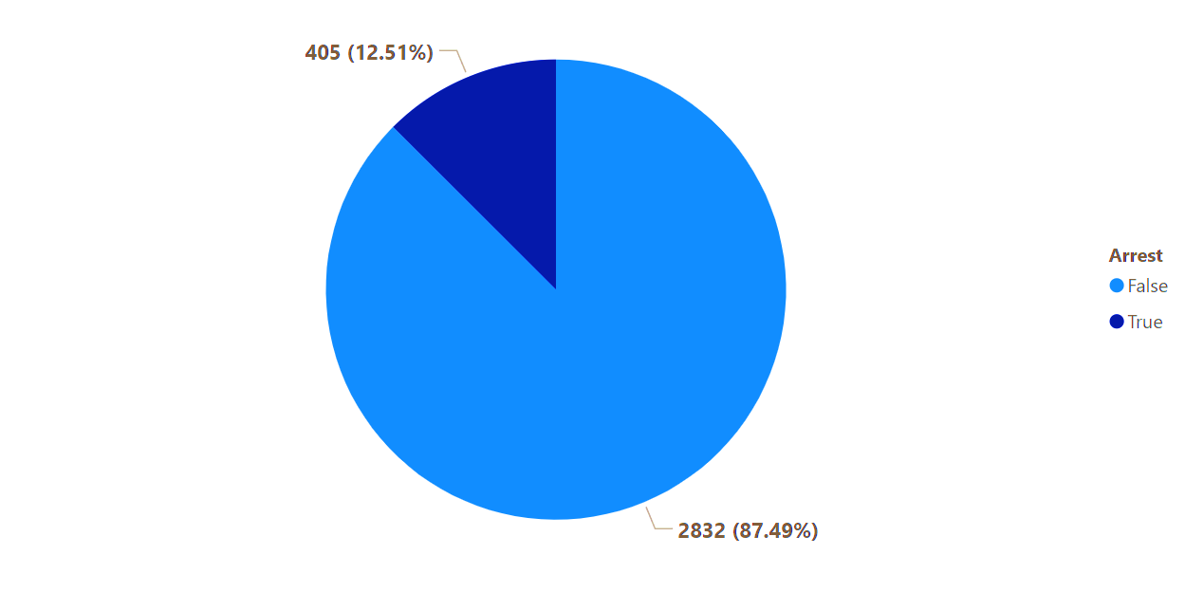
Subjective Questions
As per the previous reports, most domestic crimes do not result in arrest due to public hesitation and family pressure, is this trend also visible in our data?
Key Takeaways: -
This trend is clearly visible in our data because only 405 domestic crime cases led to an arrest out of the total domestic crime cases.
Awareness should be created among the people and encourage them to report a case.

Slide 17

Recommendations
New improved security measures should be adopted mainly in the Apartments & Streets.
CCTV cameras should be installed at hotspots to easily catch the culprits.
Emergency phone numbers should be started with immediate action.
Stricter punishments should be given to the culprits so as to create a sense of fear in the minds of criminals.
Self defense trainings should be provide to the people so that they can handle small situations.
Intelligence team should be alerted so as to catch culprits as soon as possible and decrease the pending case burden of the department.

Slide 18

“Nothing is more devastating to a community than out-of-control crime.”

Slide 19



Conclusion
Although there has been a decrease in the number of crimes after the 2nd quarter, there is a scope of improvement.
Locations like Streets & Apartments should be under supervision.
Average time to solve a case should be decreased to maintain the condition of law.
Domestic crimes should be under high priority.
People should also be encouraged to file a complaint in case of domestic issues.

Slide 20
Reference
www.wikipedia.com
www.github.com
www.kaggle.com
www.analyticsvidya.com

